Slide 1
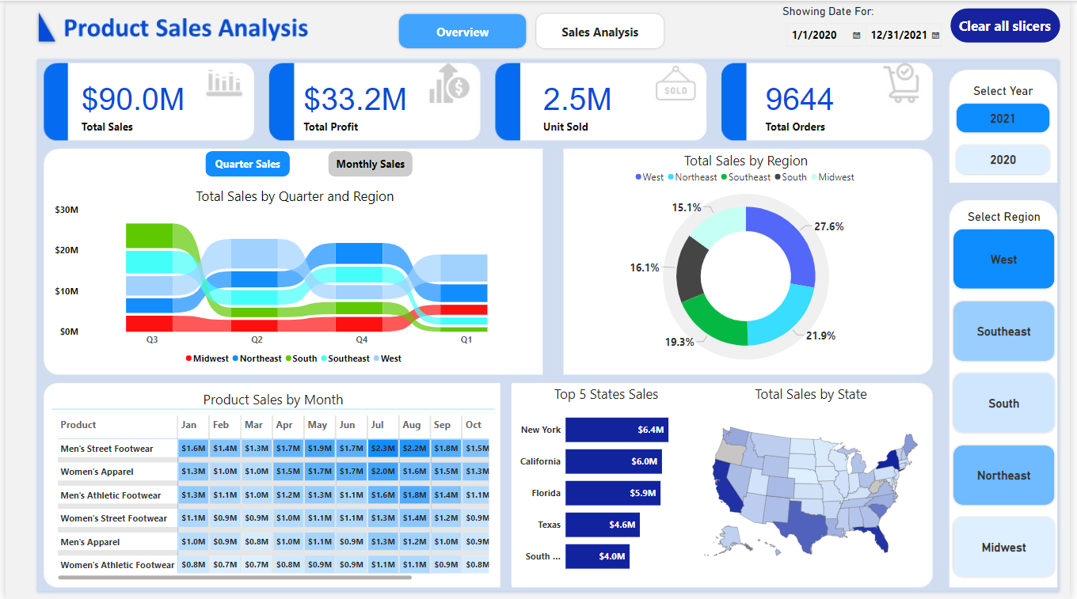

Slide 2
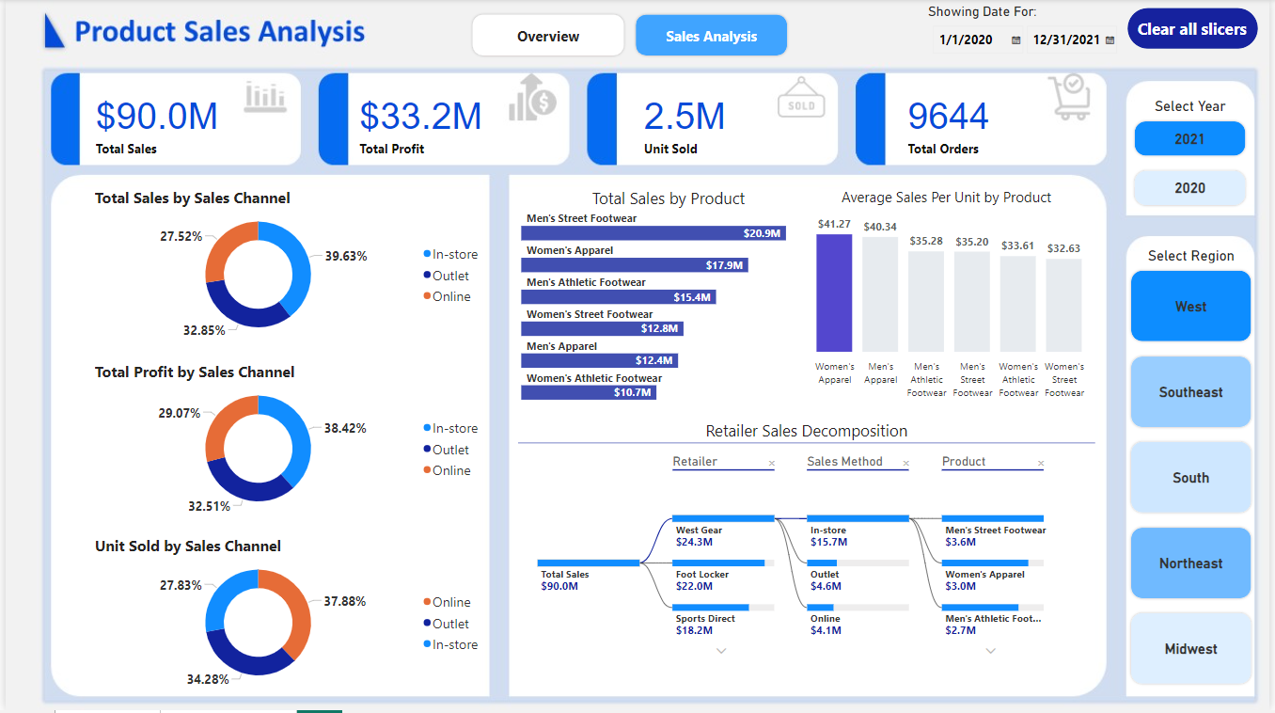

Slide 3
Product Sales Analysis
Tools Used
Power BI
Power Query to connect with the data and transform it
Create Some Tables (dim Tables From Fact Table)
Remove Unused Columns from each Table
Remove Duplicate Values
Create Measures

Slide 4
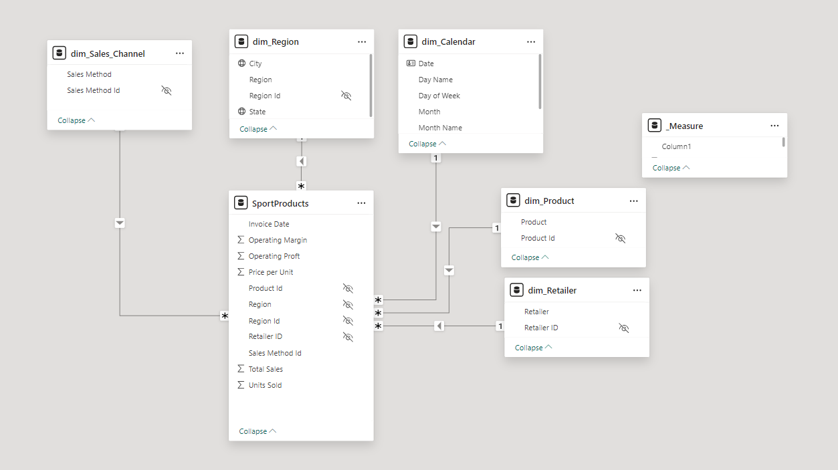
The Dataset Model view and Relationships

Slide 5
Overview Dashboard
1. KPIs
Total Sales , Total Profit , Unit Sold , Total Orders
2. Sales By Quarter and Region
Analyze sale by region for each quarter
Finding That Q3 Have the most sales specific in the south region
3. Monthly Profit and Sales Trends:
Analyze sale and profit by Month
Finding That ( Jul And Aug ) Have the most sales and Profit
4. How Sales Vary in different Region ?
Finding That West Region Have the most sales

Slide 6
5. Product Sales by Month
Analyze all product sales by month in a matrix
Finding that (Men's Street Footwear ) is the best product have the best sales in Jul month
6. Top 5 State Sales
Analyze all State sales in Map View And showing Top 5 States
Finding that New York is the best State have the best sales

Slide 8
Sales Analysis Dashboard
1. KPIs
Total Sales , Total Profit , Unit Sold , Total Orders
2. Sales By Sales Channel
Analyze sale by Sales Channel
Finding That In-Store Have the most sales
3. Profit By Sales Channel
Analyze Profit by Sales Channel
Finding That In-Store Have the most Profit
4. Unit Sold By Sales Channel
Analyze Unit Sold by Sales Channel
Finding That Best number of unit sold is online

Slide 9
5. Total Sales by Product and average Sale per Unit
Analyze all product sales by month in a matrix
Finding that (Men's Street Footwear ) is the best product have the best sales and (Women's Apparel) have the best average sale per unit
6. Retailer Sales Decomposition
Analyze all Retailer Sales Method by Products
Finding that West Gear Retailer Have the most Sales in-Store Special the product (Men's Street Footwear )

